Slide 1
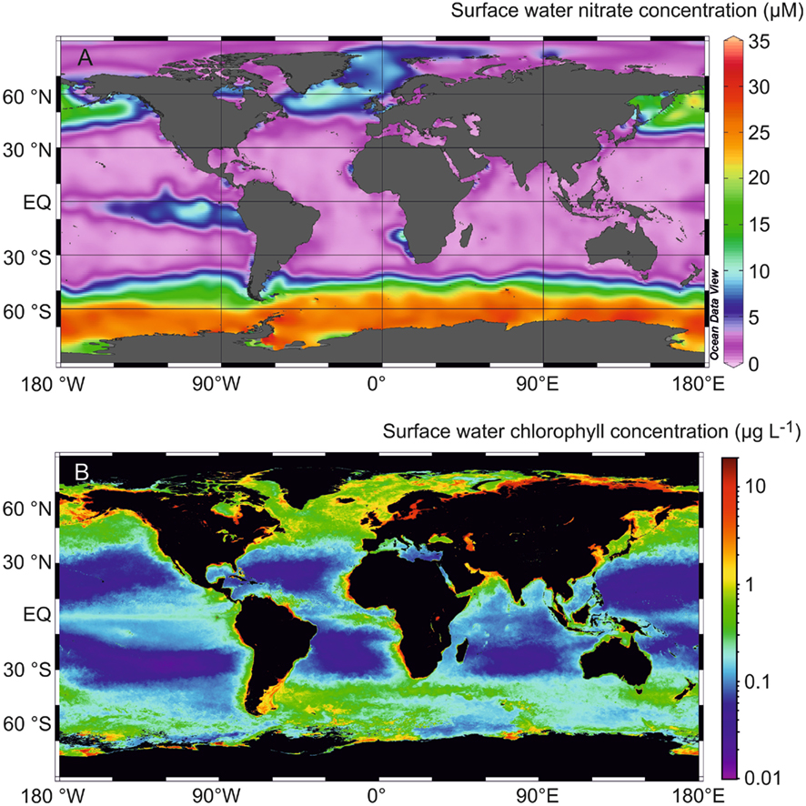
Nutrients and productivity V
5 June
2017

Slide 2
Deviations from Redfield stoichiometry
106 CO₂ + 16 HNO₃ + H₃PO₄ + 78 H₂O ↔
(C₁₀₆H₁₇₅O₄₂N₁₆P) + 150 O₂
Remineralization: O₂:C_{org}:N:P ≈ -150:106:16:1
Example 2: if remineralization of organic matter is observed to draw down 10 μM O₂, then DIC should increase by (10 x 106/150) ≈ 7.1 μM and NO₃⁻ should increase by (10 x 16/150) ≈ 1.1 μM
Also applies to oxygen

Slide 3
Apparent oxygen utilization (AOU)
The O₂ distribution in the ocean is a result of:
surface equilibration with atmospheric O₂
biological production due to photosynthesis
biological use of O₂ during respiration and remineralization
increase in deep water O₂ due to sinking of cold, O₂-rich waters
To more easily interpret the physical and biological effects on O₂, we consider the amount that is utilized rather than the total O₂ concentration:
AOU (μmol/L) = [O₂]_{calc} – [O₂]_{meas}
[O₂]_{calc} = predicted [O₂] at given temperature and salinity

Slide 4
Apparent oxygen utilization (AOU)
The O₂ distribution in the ocean is a result of:
surface equilibration with atmospheric O₂
biological production due to photosynthesis
biological use of O₂ during respiration and remineralization
increase in deep water O₂ due to sinking of cold, O₂-rich waters
To more easily interpret the physical and biological effects on O₂, we consider the amount that is utilized rather than the total O₂ concentration:
AOU (μmol/L) = [O₂]_{sat} – [O₂]_{meas}
[O₂]_{sat} = predicted [O₂] at given temperature and salinity

Slide 5
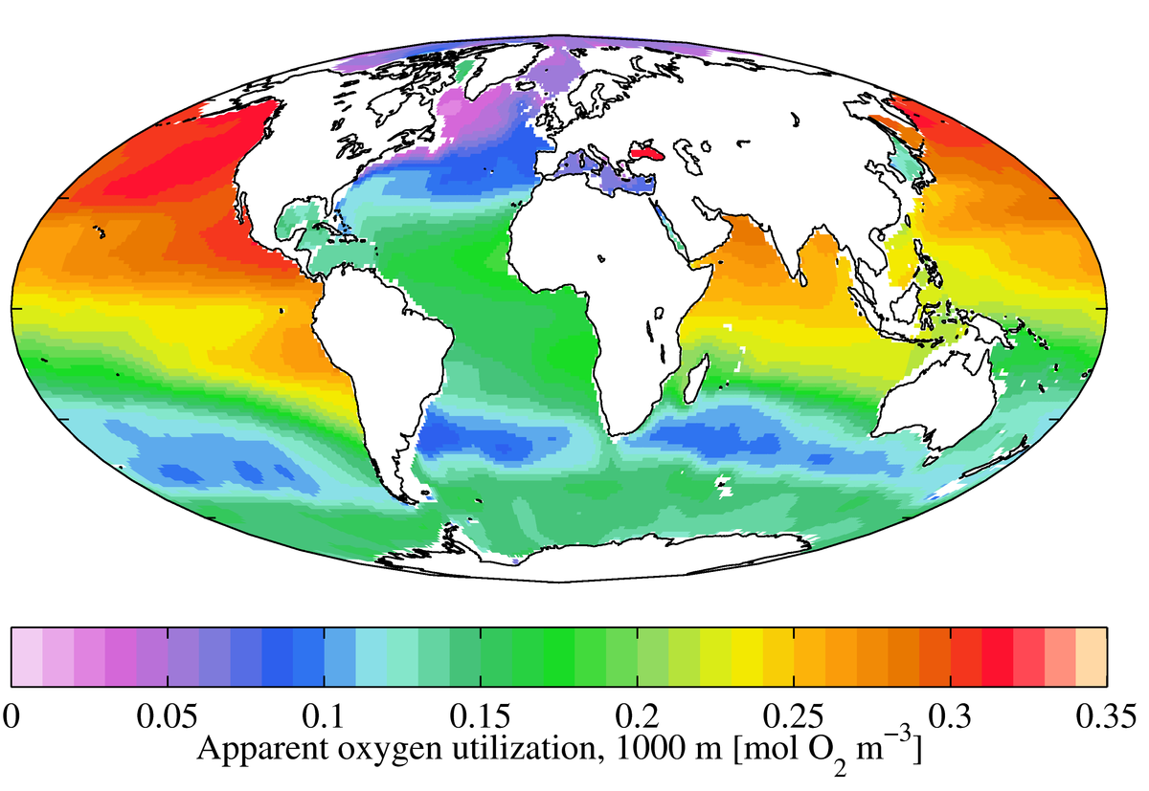
AOU at 1000 m

Slide 6
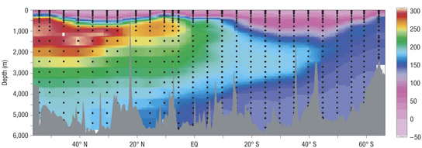
Apparent oxygen utilization (AOU)
AOU
μmol/kg
Pacific Ocean

Slide 7
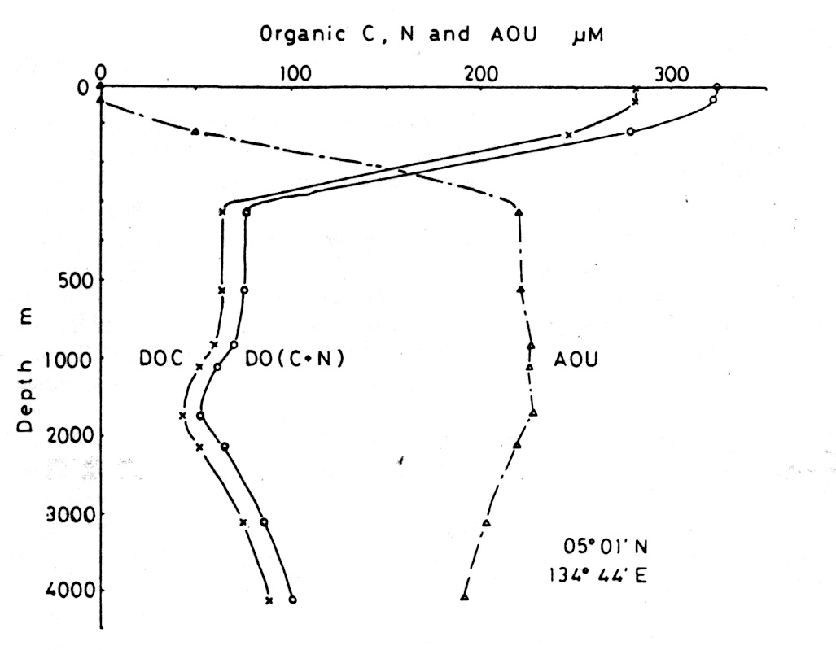
Apparent oxygen utilization (AOU)
AOU
Particulate organic carbon
Remineralization: AOU:C_{org}:N:P ≈ 150:106:16:1

Slide 8
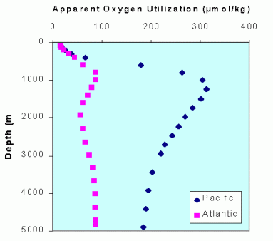
Apparent oxygen utilization (AOU)

Slide 9
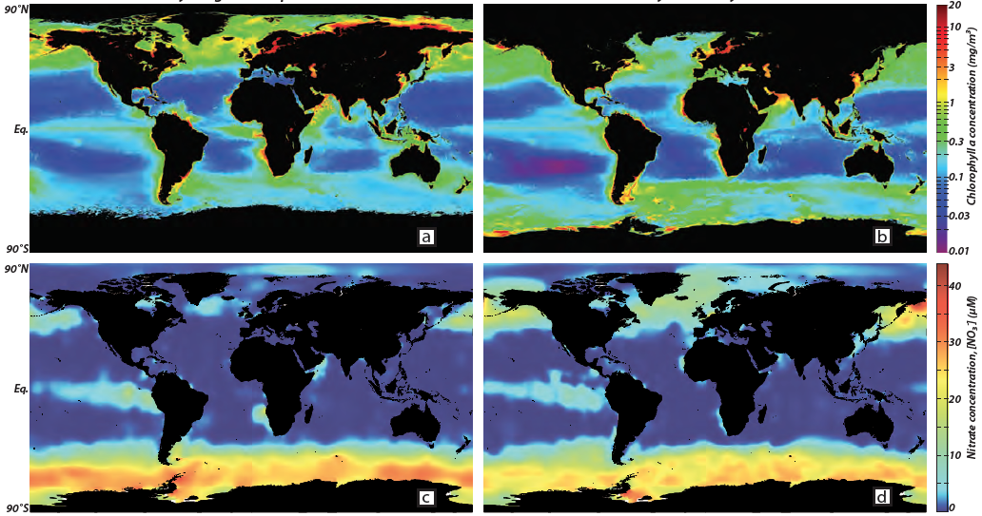
What controls the observed distribution of productivity?
Northern hemisphere summer
Southern hemisphere summer
Chlorophyll-a (mg/m³)
Chlorophyll-a (mg/m³)
[NO₃⁻] (μM)
[NO₃⁻] (μM)
oceancolor.gsfc.nasa.gov; www.nodc.noaa.gov; Sigman and Hain, 2012

Slide 10
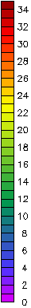
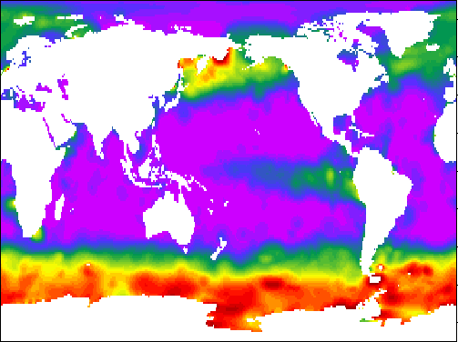
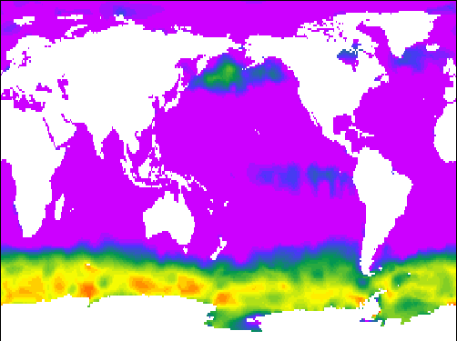
NO₃⁻ (annual maximum)
Global nutrient consumption
[NO₃⁻] (μM)
NO₃⁻ (annual minimum)

Slide 11
NO₃⁻ (annual maximum)
Global nutrient consumption
[NO₃⁻] (μM)
NO₃⁻ (annual minimum)

Slide 12
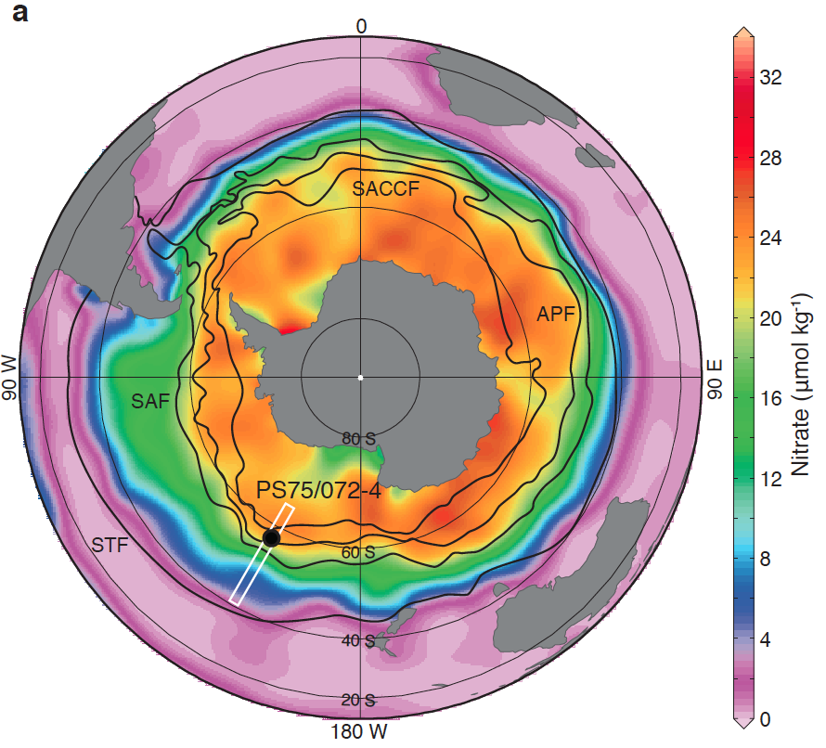
Southern Ocean HNLC
January-March [NO₃⁻]
Schlitzer 2002

Slide 13
Southern Ocean HNLC
January-March [NO₃⁻]
Southern Ocean: “leak” in the global ocean’s biological pump
Schlitzer 2002

Slide 14
The case for iron
“Give me half a tanker of iron and I’ll give you an ice age”
John Martin, 1990

Slide 15
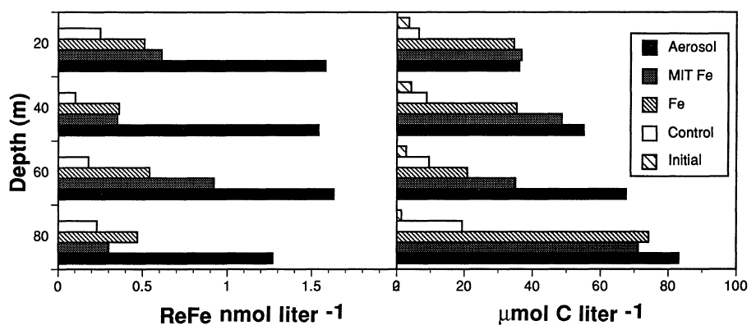
The case for iron
“Give me half a tanker of iron and I’ll give you an ice age”
John Martin, 1990
Iron concentrations (nM)
Carbon biomass (μM)
Martin et al. 1991

Slide 16
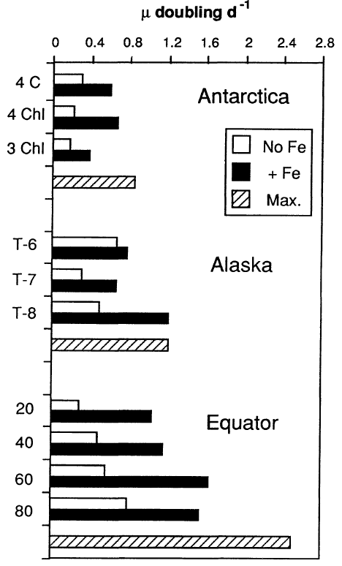
Growth rate (d⁻¹)
Southern Ocean
Subarctic N Pacific
Equatorial Pacific
Martin et al. 1991

Slide 17
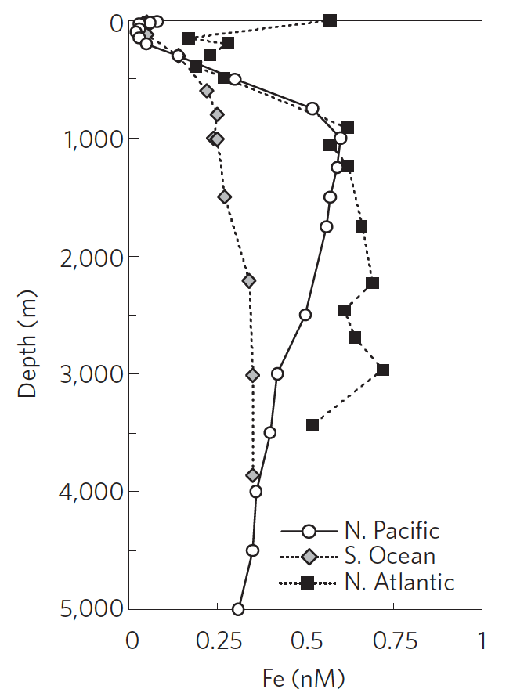
Dissolved iron (Fe) in seawater (nmol/L)
“nutrient-like” profile
Boyd and Ellwood 2010, Coale et al. 2009

Slide 18
Dissolved iron (Fe) in seawater (nmol/L)
“nutrient-like” profile
Boyd and Ellwood 2010, Coale et al. 2009

Slide 19
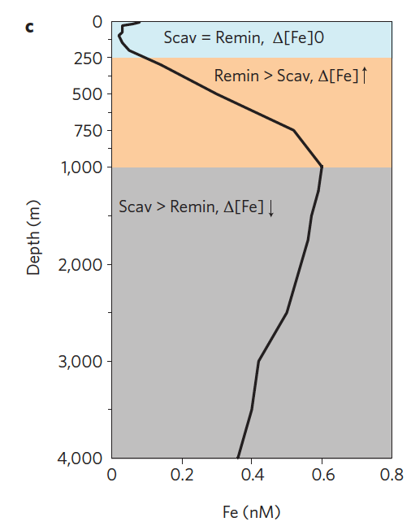
Dissolved iron (Fe) in seawater (nmol/L)
Consumption
“nutrient-like” profile
Remineralization >
Scavenging
Scavenging >
Remineralization
N Pacific
Boyd and Ellwood 2010, Coale et al. 2009

Slide 20
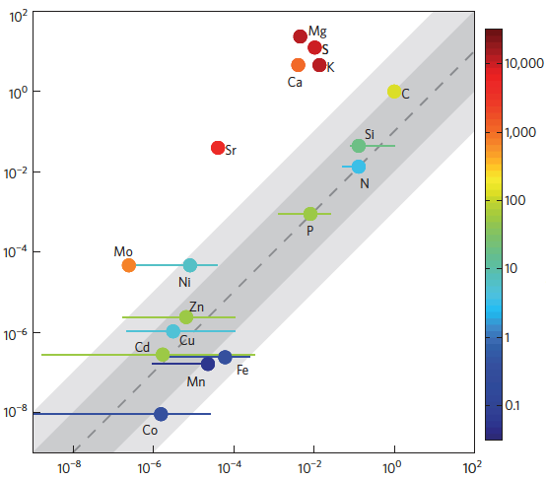
Nutrient limitation
mean dissolved seawater ratio (normalized to C)
residence
time (years)
cellular ratio (normalized to C)
Moore et al. 2013

Slide 21
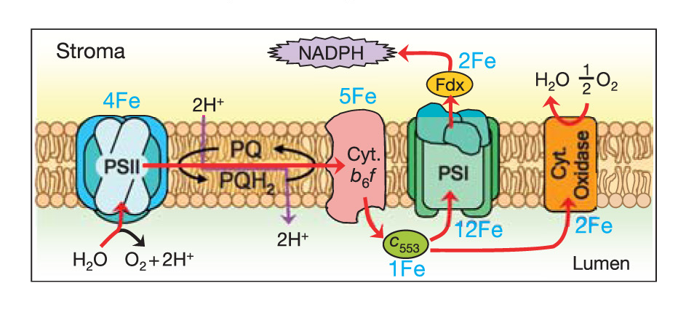
Iron limitation of phytoplankton
Photosynthesis (and respiration)
Phytoplankton need IRON in addition to light and nutrients
Behrenfeld et al. 2006

Slide 22
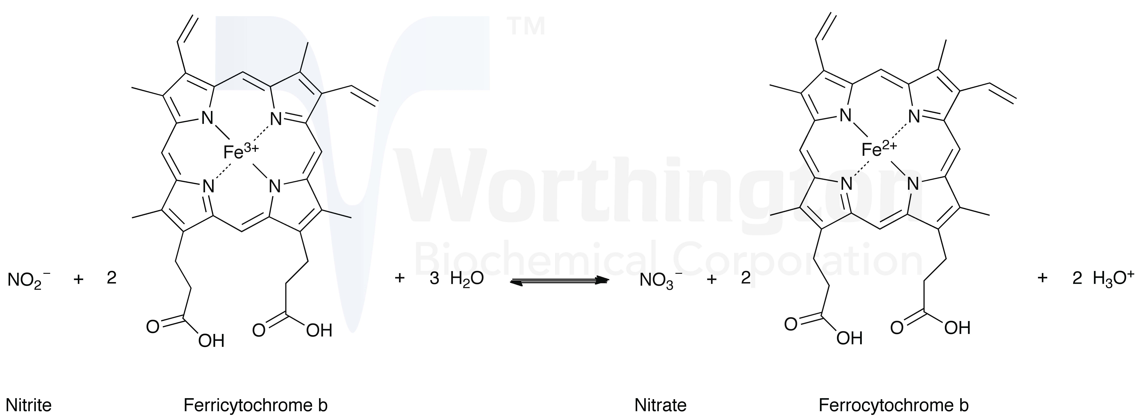
Iron limitation of phytoplankton
Nitrate reductase: NO₃⁻ assimilation
Phytoplankton need IRON in addition to light and nutrients

Slide 23
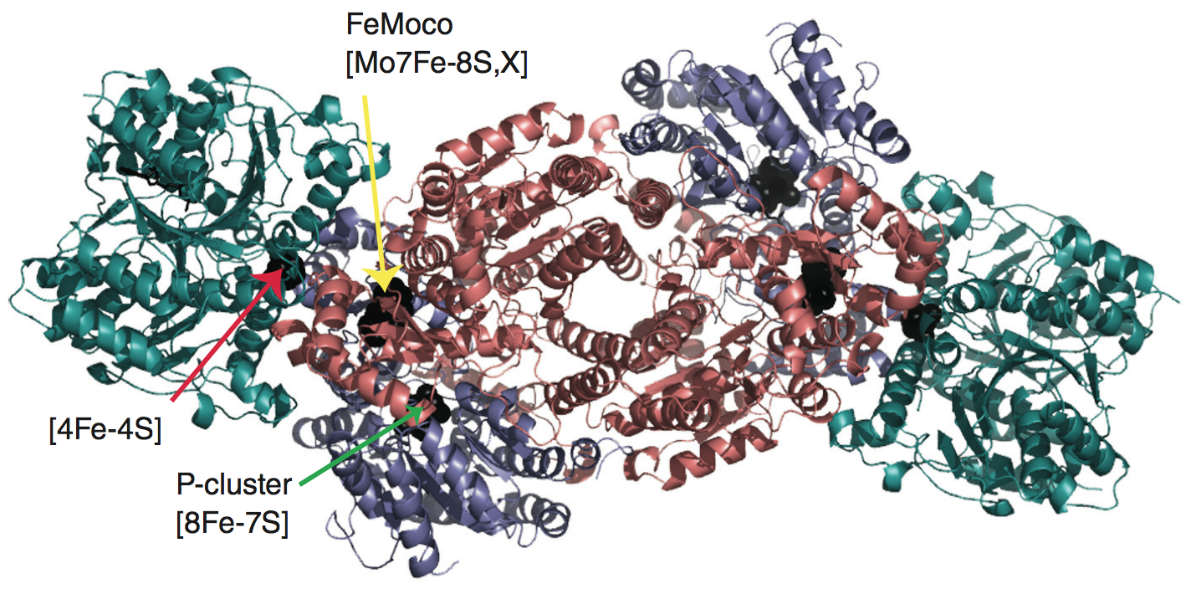
Iron limitation of phytoplankton
Nitrogenase: N₂ fixation
Dixon and Kahn 2004

Slide 24
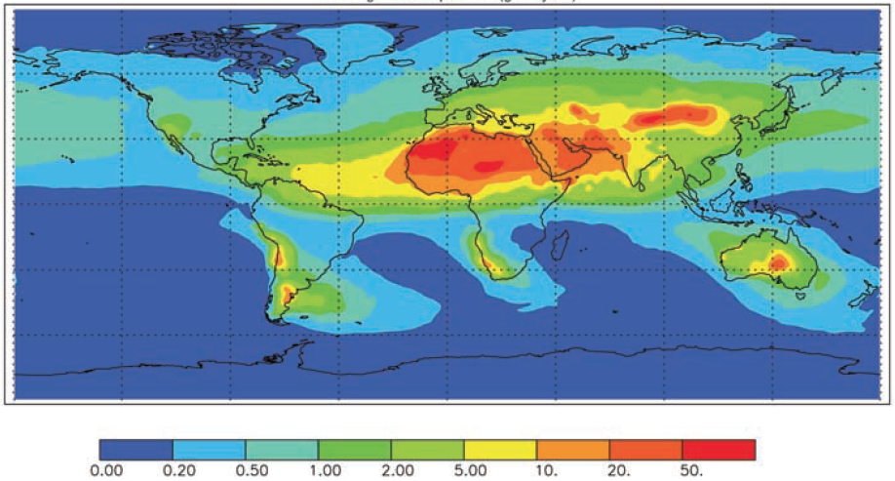
Sources of iron: dust
15%
43%
25%
6%
4%
6%
Average dust deposition (g/m²/year)
Jickells et al. 2005

Slide 25
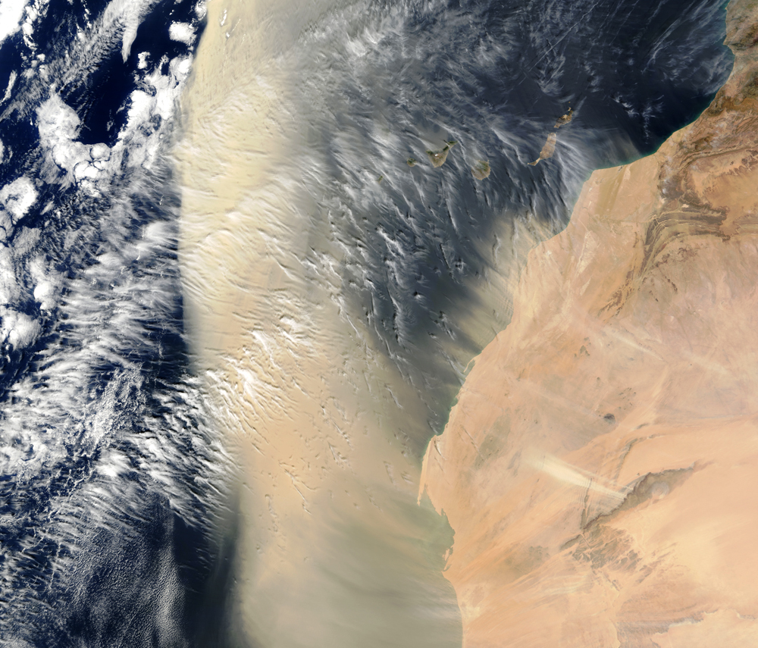
Dust “fertilizes” the ocean with iron

Slide 26
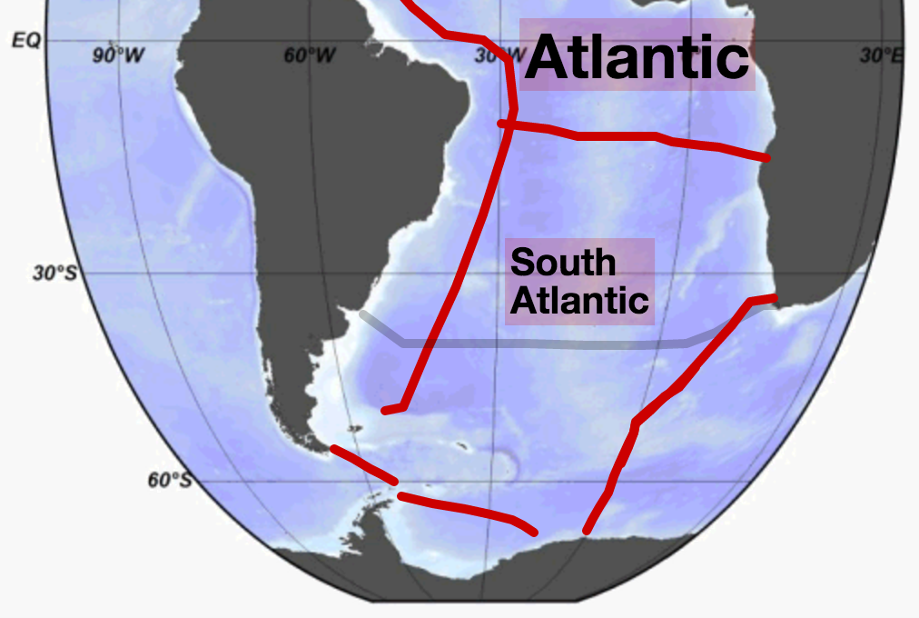
Dissolved iron in the South Atlantic
http://www.egeotraces.org/scenes/SAtl_Fe_D_CONC_BOTTLE.html
http://www.egeotraces.org/

Slide 27
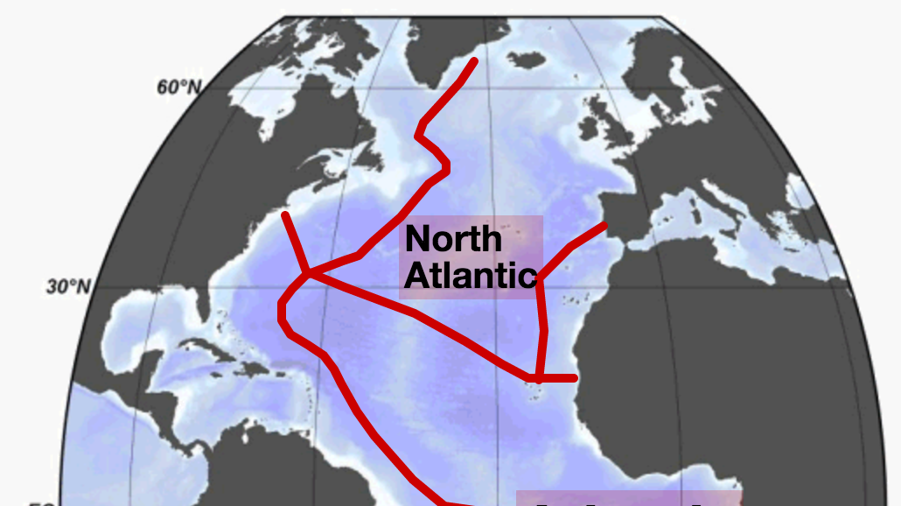
Dissolved iron in the North Atlantic
http://www.egeotraces.org/scenes/NAtl_Fe_D_CONC_BOTTLE.html
http://www.egeotraces.org/

Slide 28
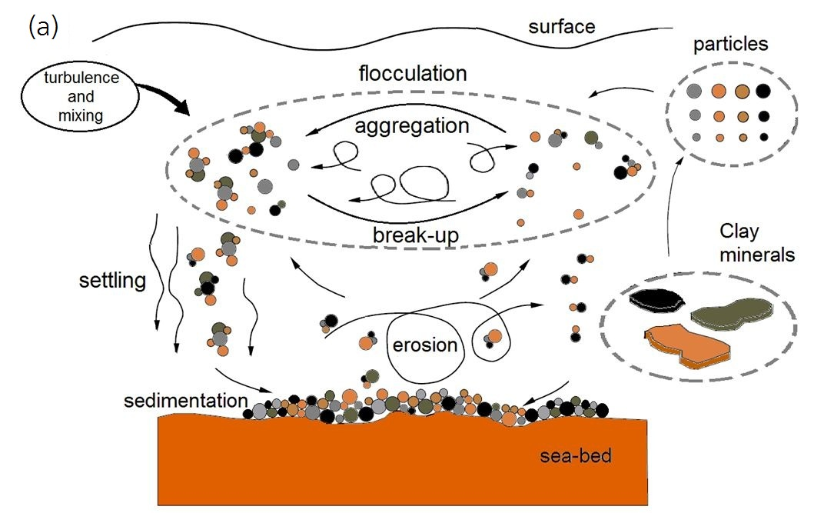
Sources of iron: sediment resuspension
Wang and Andutta 2013

Slide 29
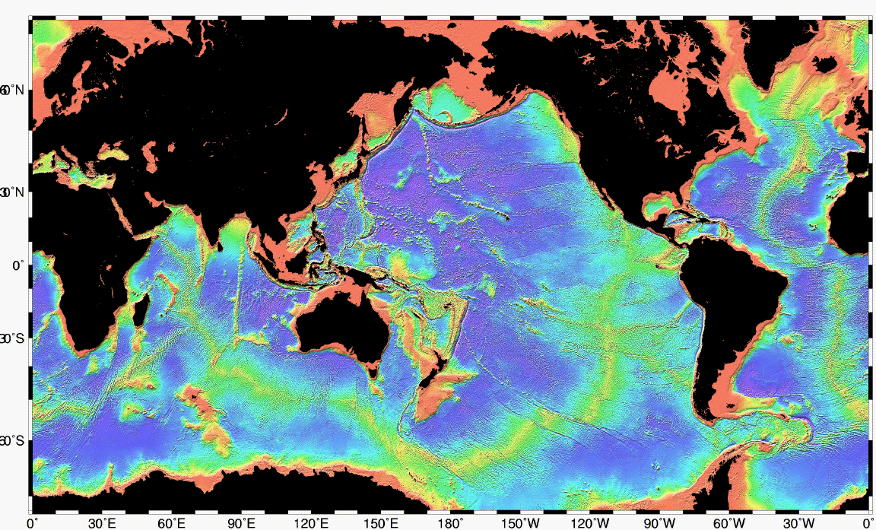
Sources of iron: sediment resuspension
Iron supply highest near the continents
Bathymetry

Slide 30
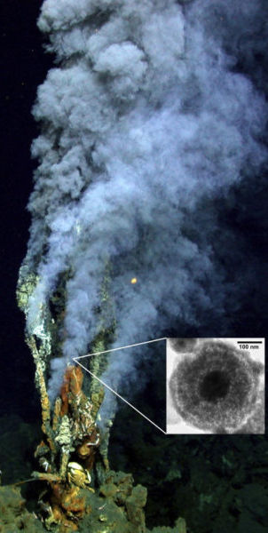
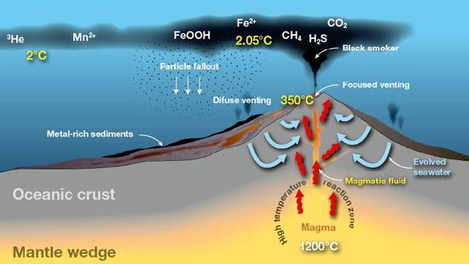
Sources of iron: hydrothermal

Slide 31
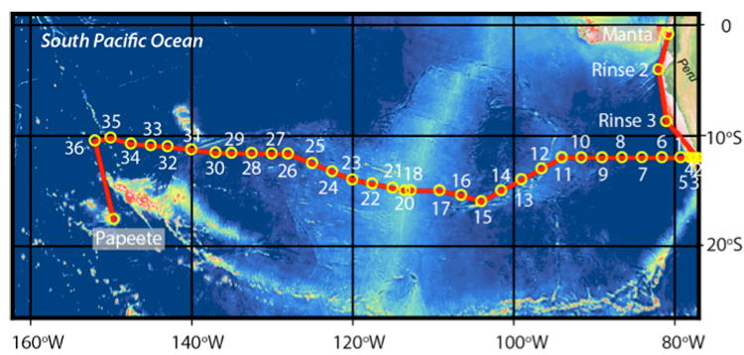
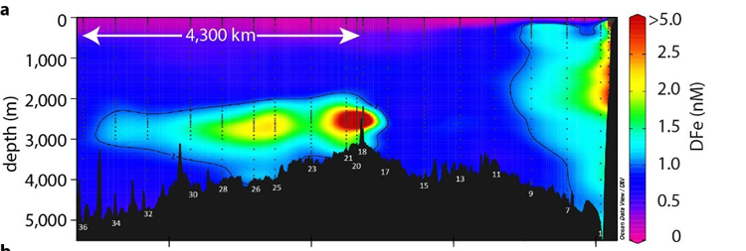
Sources of iron: hydrothermal
Resing et al. 2015

Slide 32
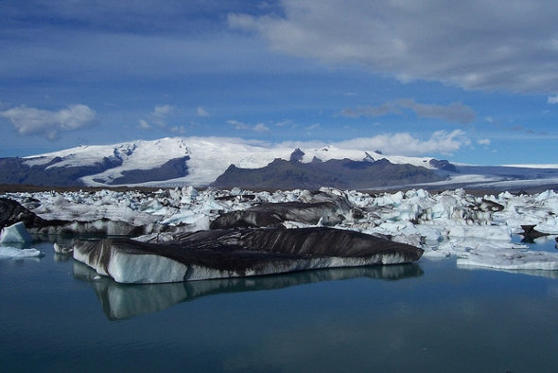
Sources of iron: ice
Atmospheric iron trapped in ice
Iron particles scraped from bedrock by moving ice

Slide 33
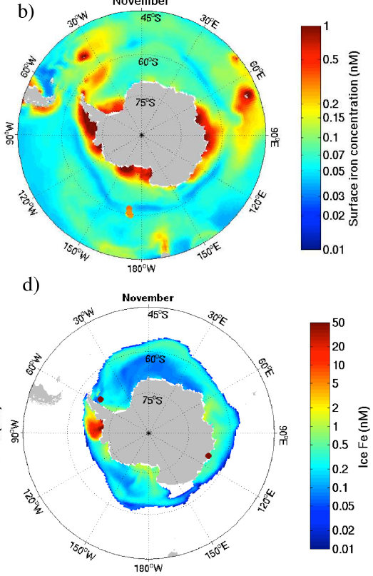
Sources of iron: ice
Seawater iron concentrations (spring)
Iron concentrations in ice (spring)
Wang et al. 2014

Slide 34
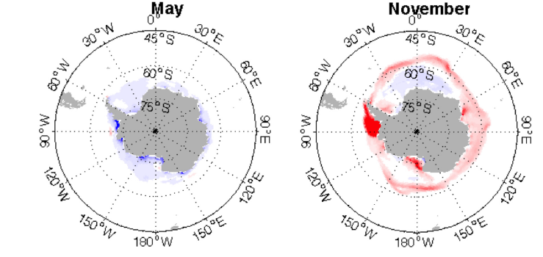
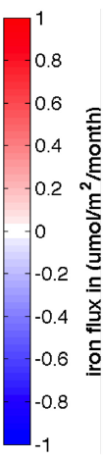
Sources of iron: ice
Iron fluxes: blue – from seawater to ice; red – from ice to seawater
Autumn: iron is removed from seawater by ice formation
Spring: Iron is released to seawater during ice melt
Wang et al. 2014

Slide 35
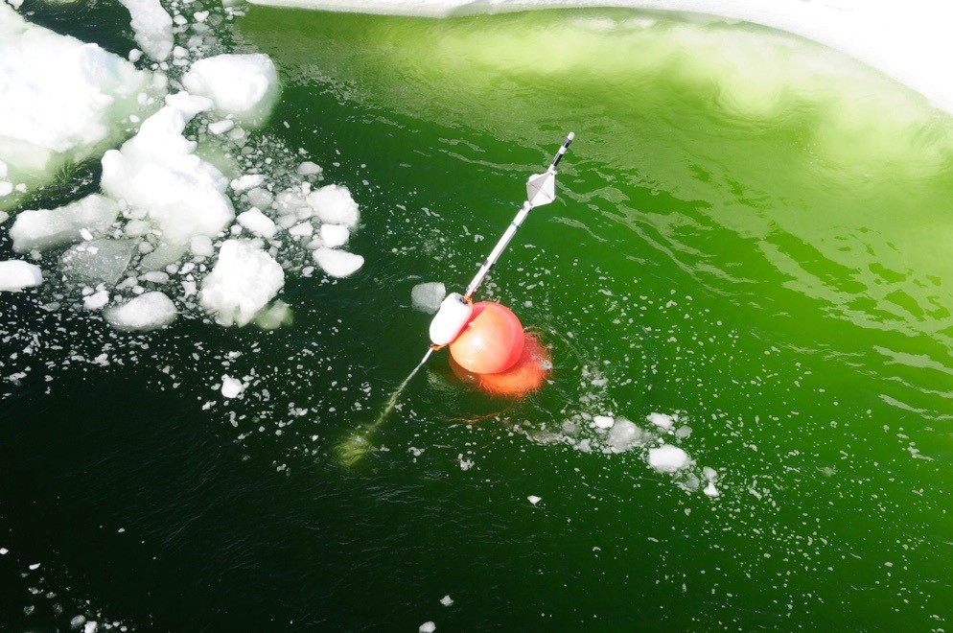
Sources of iron: ice
Ice-edge phytoplankton bloom

Slide 36
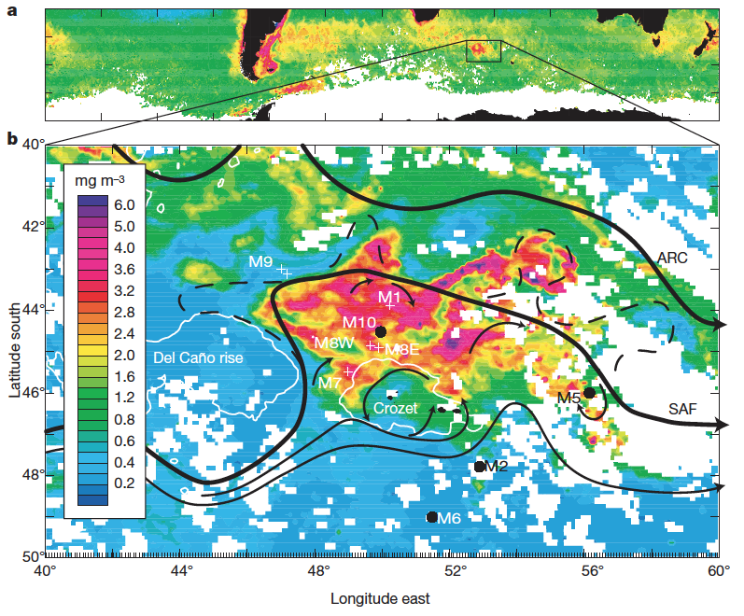
Natural iron fertilization experiment
Crozet plateau
Pollard et al. 2009

Slide 37
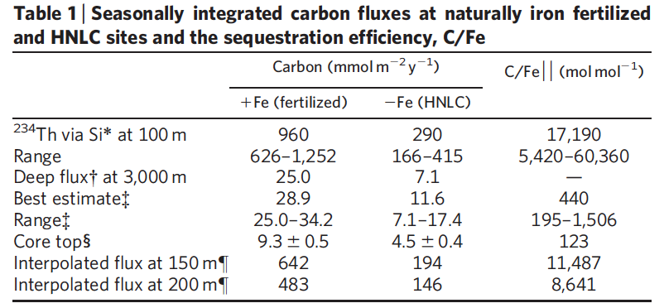
Natural iron fertilization experiment
Addition of iron strengthens the SO biological pump
Pollard et al. 2009

